Slide 1

District 5020
Outbound Orientation
Welcome to Day 2
March 26, 2017

Slide 2
Travel
Becky Fontaine and
Charlie Kocher

Slide 3
Travel in General
Passports and visas
  Post Arrival Instructions
Airline tickets & documents
Airport security & check in
Emergencies, early & scheduled returns

Slide 4
General Time Line
March – orientation, VISA – pick a processing company and start to compile documents.
Some documents take 90 days to acquire so start early.
April-May-June - verification of documentation; host guarantee confirmation and processing VISA applications with consulates.
June-September –VISA approval; issue tickets and departure to assigned country.

Slide 5
PASSPORT AND VISA

Slide 6
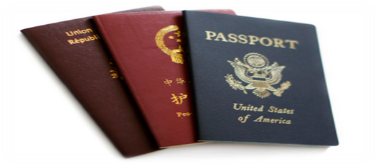
Passports
Passport is a form of identity – confirms who you are.
Passport must be valid thru January 2019.
  At least one parent or guardian should have a valid passport.
Some countries will require your passport as part of the visa process.
Keep copies separate from original passport.
Keep passport safe at all times!

Slide 7
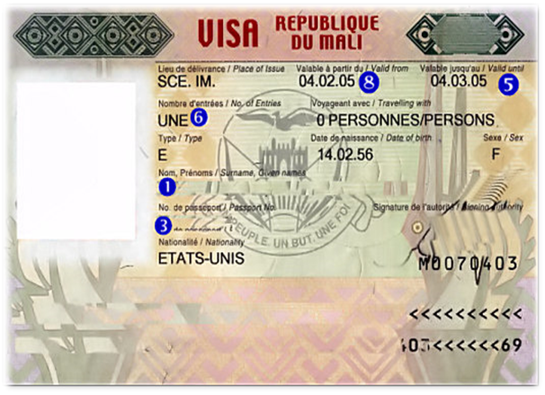
Visas, etc.
Visa is an authority (permission)
issued by a country or consulate
permitting a non-citizen to enter, transit or remain in
their country for a designated period of time.
Process and documents are different for every country and can vary from consulate to consulate and change at ANY moment!
Some visas are stamped in your passport and some are separate documents.
Passport will be returned with visa approval.

Slide 8
Visa Acquisition
You CAN navigate your own VISA a process by following the instructions provided by your host country or
You can pick a visa service agency or
Some companies do visa, ticketing and travel advice throughout your exchange.

Slide 9
Visas
Parents and students may be asked for their assistance in helping to document the visa application process.
A questionnaire will be sent for completion and return.
This will help us help students in the future.

Slide 10
Visa Processing Companies
Canada
Visa Universe
www.visaunivserse.com
info@visaunivserse.com
International Visa Passport Service Corporation
www.ivpsc.com
USA
travisa - www.travisa.com
G3Visas - www.g3visas.com

Slide 11
AIRLINE TRAVEL
Tickets
Baggage
Departure and Arrival

Slide 12

Airline Tickets Requirements
Must allow for quick return in the event of an emergency.
Airline change fees may start
at $250US and may be more
for weekend/holiday travel.
Airline frequent flyer rewards are ABSOLUTELY NOT permitted.
A copy of your airline ticket with change rules must be submitted to your Country Officer.

Slide 13
Airline Tickets
It’s Your World Travel
Package Services – visa/ticket/travel support for
18 months
Different coaches for different countries
Phone: 1-206-242-1969 or 206-328-0625 (24/7)
www.iywt.com
STA (Student Travel Assistance – ticketing only)
Jeff Mathews
Phone: 1-800-495-5702
Email: jeff.Mathews@statravelcom

Slide 14
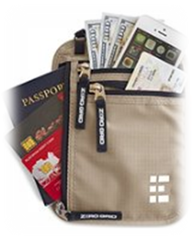
Keep Documents Safe
Keep passport, boarding pass,
visa, parent permission to
travel and copy of your Guarantee Form
with you and secure at all times!
Leave hard COPIES with your parents.

Slide 15
Who needs to know to what
Communicate your travel plans to both your host family and host Rotary Club as soon as you know your flight details.
Make sure to communicate ALL flight info: airline(s) name, flight numbers & arrival times.
Confirm that your travel plans have been received and who will be at the arrival airport.

Slide 16
Security Before the Airport
Wear your Rotary blazer.
Valuables such as jewelry, cash, laptop computers and electronics should go in carry-on bags.
Be prepared to un-pack your carry-on bags at security gates.
Avoid wearing clothing, jewelry and accessories that may set off the metal detector at check points.
Do not pack wrapped gifts or bring wrapped packages to the checkpoint.

Slide 17
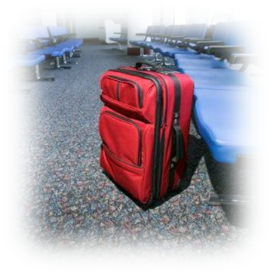
Security At the Airport
Be prepared for security screening of your carry-on items.
Do not joke with any immigration, customs, or security officers - answer questions politely.
Never discuss such issues as bombs, terrorist activities, or anything remotely
related.
Never accept any items from
strangers.
Never leave your belongings
unattended!

Slide 18
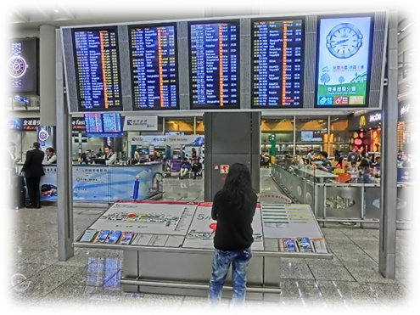
Airport Check In
Three hour advanced check in
prior or to departure.
Be prepared to present your passport/visa, parental consent & confirmation code or reservation acknowledgment at airline counter.
Electronic ticket passengers (e-ticket) will need proper documentation from air carriers such as an acknowledgment of reservation or record locator.
Be prepared to show your passport and boarding pass more than once at various check points.

Slide 19
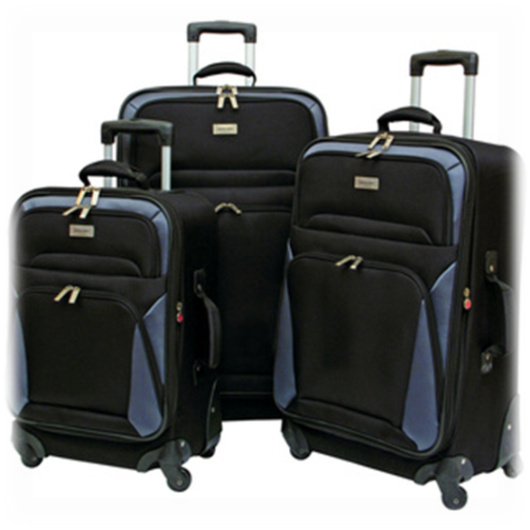
Baggage Allowances
Allowances vary from carrier to carrier – check before you pack.
If you have two airlines you need to check both.
Be prepared to pay fees for all checked pieces.
Be prepared to check carry on items (except handbag or laptop or small day pack).
Excess baggage fees range from
$75 - $300 per piece. This may
be cheaper than shipping.

Slide 20

Airport Transiting
Request that your luggage is tagged to your final destination - and then confirm that this was done.
When going through customs and if changing airlines, you may need to handle your luggage – ask when you check-in.
Do not delay between connections and do not leave the transit area when making connections!
Pay attention to announcements –
your name may sound different –
watch monitors for changes in departure gates.
Airline staff are there to help you. If you don’t know where to go – ask! ASK and ASK AGAIN!

Slide 21
OMG – I’m Stranded!
If you miss a connection or if your flight is cancelled or the airline has to change your itinerary,
  Go to the nearest airline counter and ask for instructions in writing
  Contact your parents, host parents and Rotarians and give them this information
  This is why your documents are so important to have.
Add info about Travel insurance through CISI Bolduc
Make sure you have useable debit card or some cash for food, taxi, or other emergency needs.
Airline staff are there to help you. If you don’t know where to go – ask! ASK and ASK AGAIN!

Slide 22

Arrival at Host Country
Clear immigration.
Pick up your baggage and then clear customs.
Have important phone numbers for parents, host family and Rotary on your person for use.
Wear your Rotary blazer and your smile so your host family will recognize you!
If you are traveling with other Rotary students don’t leave them behind.
Never leave the airport with strangers!

Slide 23

Register your trip
Register with the nearest Canadian or US embassy or consulate with the travel registration program in case of an emergency situation or a disaster overseas.
(US travelers can register
in advance.)

Slide 24

Coming Home
Emergency or early returns - contact Rotary sponsor immediately and have them request assistance from the travel agency for early return
In the event of an extreme emergency – obtain permission to return home & contact the airline directly
Start to plan your return home in January
and notify your travel agent
Change fees may apply
Make sure departure date falls
before visa expires or 15-July.

Slide 25

Health and Accident Insurance
Becky Fontaine

Slide 26

Health Insurance
Every student MUST have
insurance.
In most cases, the full cost is already
included in the Outbound Fee.
Some countries will demand you buy theirs, if so and adequate, we will refund a portion of the Outbound Fee. Your Country Officer will let you know if you must buy the host country insurance.

Slide 27
Health Insurance
Our district insurance exceeds Rotary International’s minimum level.
Insurance Policies are issued for Aug. 1 thru July 30. Please advise your Country Officer and CISI of your exact date of departure, so your policy dates can be adjusted.
All Students purchase insurance from
CISI Bolduc – Plan B
  Policy Booklet and application form available
  for downloading.
  Complete the application and give to XXXX.

Slide 28
Important things to remember
Learn about your coverage before you leave.
Always carry your insurance card with you.
Contact your insurance company as soon as you are
aware that you may have a claim.
Keep a copy of your insurance information in your
safety envelope with your host family and host YEO.
Document all possible claims as soon as possible.
You must report any stolen or lost items to the police
and ask for a written report in order to file an
insurance claim.

Slide 29
Important things to remember …..
Medical insurance claims are on-line and should be
submitted with receipts for your expenses.
If you come home early due to medical reasons and
use the trip interruption coverage, you must have
documentation from the doctor recommending
your trip home.
When in doubt – ASK!

Slide 30
All other insurance questions
CISI-BOLDUC
River Plaza
9 West Broad Street
Stamford, CT 06902-3788
Phone: 800-303-8120
Fax: 203-399-5596
E-mail: cisiwebadmin@culturalinsurance.com

Slide 31
Good Morning Announcements
Maureen Considine

Slide 32
Blazers, Pins, Presentations, Banners and Gifts
‘Be Grateful’
Paul Ofsthun

Slide 33
Blazers
Navy blue is our traditional color
  Get one big enough for weight gain
  Don’t spend a lot of money on it
  Try Goodwill, Salvation Army or the local thrift store
D5020 emblem and name badge on breast pocket – check for a local embroider
Country flag on shoulder

Slide 34
Pins to Trade and as Gifts
Pins (to trade with other students)
  250 is a good number
  Pins should represent your area or country
Sources of pins are:
Chamber of Commerce
Local industries, Trade Assns.
Make your own, be creative
District 5020 pins will be available for sale this weekend

Slide 35
Your Presentation
Every student is expected to give one. You may be asked to give it at your first Rotary meeting.
Have slides (PowerPoint) to show:
Your home, family and family life
Your hobbies, interests, and friends
Home town and school
Local points of interest
Books and pictures to pass around work well
Notes:
Think about comparing the two cultures

Slide 36

Rotary Club Banners
If possible …. Formally present your sponsoring club’s banner to your host club at your first meeting
Your host club will give you a banner in
return for your sponsoring club
Get your club banners from
secretary of your sponsor club.
Ask for a few extra to give to
other clubs you may visit.

Slide 37
Host Families
Gifts for your First Night
Be prepared with a small gift for each member of the host family
Ideas?
– Something from where you live
– Something you made
– Books about your country or town
Notes:
Reference list provided in packet

Slide 38
Gifts in General
Gifts for those who entertain you
Have thank-you cards
Be ready for Christmas
Have family members at home supply you – arrange early
Have gifts for each of your host families

Slide 39
Travel and the Law
‘Be on Purpose’
Ron Fisher

Slide 40
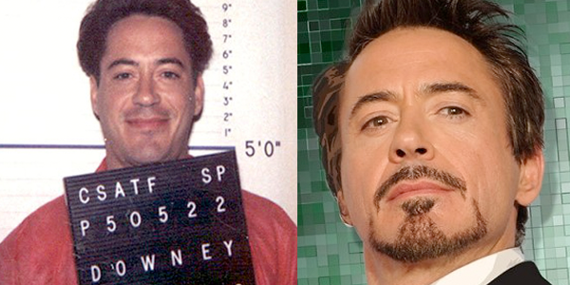
The Law and Travel
Why is this important to talk about??

Slide 41
The Law and Travel
In North America, we believe all persons
are innocent until proven guilty – this is
not the case in many countries you will visit
The rights of accused persons are protected
Police tolerate physical and verbal abuse daily and their reaction is minimal
You are entitled to speak to a lawyer, communicate with your family.

Slide 42
The Law and Travel
This is not the case in many of the countries you will be visiting
The burden of proof lies with the accused
You can be detained without charges for long periods of time
The jails are not to the same standard as ours

Slide 43
The Law and Travel
Each year, 500 Canadians and 3,000 Americans are imprisoned abroad
One third of these are from drug offences
The Canadian Charter of Rights and the
American Miranda rights do not protect you
Some countries presume guilt by association

Slide 44
The Law and Travel
Drugs
Use and trafficking are prohibited in all countries, even though they may be readily available and openly used
Penalties can range from heavy fines and prison sentences to death for possession of even small amounts
Americans and Canadians are visible!!

Slide 45
The Law and Travel
There are many countries where the death penalty is in place
Malaysia
China
Vietnam
Iran
Thailand
Saudi Arabia
Singapore
Cambodia
Indonesia to name a few!

Slide 46
The Law and Travel
Am I scaring you yet???
I should be… well just a little..
The reality is you have termendous control over your own safety by managing your risk in everything you do!

Slide 47
The Law and Travel
Don’t carry anything across a border
for a stranger!
Never cross a border with a hitch hiker or as a hitch hiker with a stranger
Never leave your luggage with a stranger or unattended – even when you are in the bathroom!
In some Islamic countries, alcohol is looked on the same as drugs

Slide 48
The Law and Travel
Respect Customs & Practices
Some countries do not respect our freedoms, DON’T CRITICIZE THEM!
Stay away from public demonstrations
Beware of taking photographs of police or military personnel
Keep a low profile and stay neutral

Slide 49
The Law and Travel
Travel Documents
Your passport is a very valuable commodity
Never carry tickets, passport and wallet together

Slide 50
The Law and Travel
Use of tolerance, humor, respect, patience and common sense …….
will go a long way for you in your year abroad

Slide 51
Packing ‘Your’ Attitude
‘Be of Service’
Craig Gillis

Slide 52
Early Returns…… Why?
Five to ten percent of you will come home early. It happens every year….
VS
Sixty percent of you will look back on this year as one of your greatest achievements
What is the difference? -- ATTITUDE

Slide 53
Two Questions…..
What will you bring to your experience as an exchange student?
What will you leave with at the end of your year?

Slide 54
the ‘Shoe box of Life’

Slide 55
Common Errors that Cause Challenges
Failure to learn the language – Do it before you leave!
Lack of dedication / effort – Successes take work!
A boyfriend or girlfriend at home
Student never leaves home mentally---Facebook!!!
Lack of attention to school as an important element of the exchange
Not realizing that host families are volunteers, not servants
Undisclosed medical problems
Lack of communication with hosts and Rotary
Parents unwilling to let go!

Slide 56
The Six B’s: Your Guide to Success
Be First – I am a person of action / I take initiative
Be Curious – I will seek to understand (and then to be understood) - I ask questions / I am genuine
Be on Purpose – I am certain of my outcome and move steadily towards it – I set ‘goals’…..
Be Grateful – I focus on things I can be thankful for
Be of Service – I give of myself freely / I ‘offer’ to…..
Be Here and Now – I will live in the moment / I listen and observe ….. I am involved

Slide 57
Family Emergency
Make plans before student leaves - how to
handle a family emergency or death
Say goodbye to elderly and sick before you leave
Parents, do you really want your student to come home and not return?
Be prepared for financial and emotional implications if they do return

Slide 58
Start each day with intention and end with gratitude;
you will make the most of this gift – the gift of spending one year learning more about yourself
and others than you have ever dreamed possible!

Slide 59

Networking Break
Don’t forget to
Check out of your hotel!
Please be ready to start by 10:25

Slide 60
Communication
‘Be Here Now’
John Stockwell

Slide 61
Popular Forms
Email
Social Media
Blogs or blogspots
Photo Storage
Skype
Texting/Tweeting

Slide 62
A whole new language
Today’s language looks like a foreign language
  lol; brb; bff or g2g
It is how young people WE all communicate today

Slide 63
Cyber Sense & Cyber Safety
Once on the internet; always on the internet!
  Friends now or in the future
  Prospective colleges
  Future employers, spouses, family members
  Even “disappearing” sites don’t disappear
To much information is not a good thing
Tagging photos
– a great way to organize
  respect a person’s wishes not be tagged or if they un-tag a photo

Slide 64
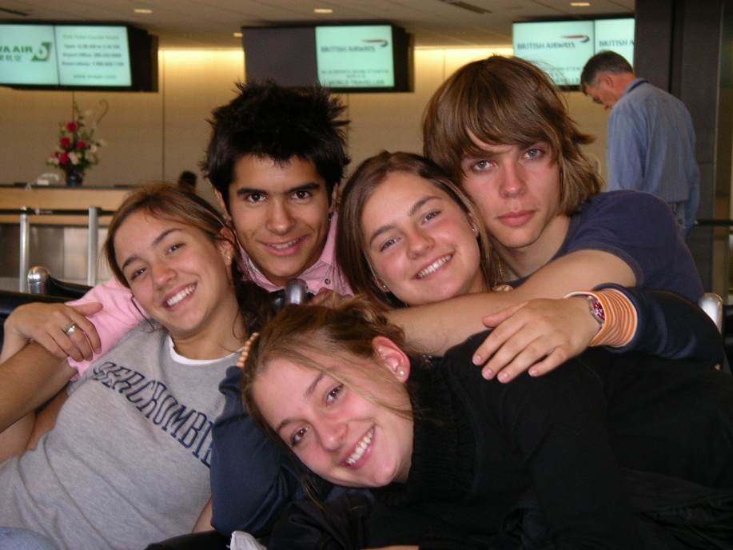
Remember the saying
A picture is worth a
thousand words –
What will your
pictures say about you?

Slide 65
Communicating in general
Limit direct communication in early months - It will help with your adjustment, especially your parents adjustment
Talking on the phone to home (especially in your primary language) can make your hosts feel left out
Manage your e-mail, Skype, social media (Facebook, etc) and text messaging activity. It keeps you from communicating with your hosts. They can get offended and irritated.
If you are e-mailing home frequently and checking the internet for home news – you have not started your exchange.
Internet time in foreign countries can be very expensive.

Slide 66
Caution
Host parents and clubs have the right to limit your computer and phone use – even it if is your personal property.
Don’t plan regular and routine contact with your family and friends at home – it shows a lack of respect for your host family.

Slide 67
Home Ties and Communication
Packages
  Surface mail is least expensive, but takes planning
  Airmail is significantly more expensive
Other Tips
  Parent, keep a home clock with student’s new time
  Use a postage meter, not stamps
Be a Diplomat – Be an Ambassador
  Write your Sponsor Rotary Club
  Write quarterly reports
  Write your local newspaper

Slide 68
Travel During Your Year Away
‘Be Here Now’
Sarah Bryant and
Maureen Considine

Slide 69
Student Travel
Definition –Travel leaving your host village, town or city
You might travel on your own, with your host family or a Rotary approved family, or on a Rotary sponsored and chaperoned trip
Your host district rules will apply and you must follow those rules

Slide 70
Student Travel
On Your Own
Your host district may allow travel alone. Ask first and provide a detailed itinerary. If they say NO, don’t argue. You may need to have a certain language level.
You may need permission of your natural parents, your host parents, counselor and District Chairman. Follow district rules.
Communicate with host parents along the way
Plan ahead

Slide 71
Rotary Sponsored Trips and Tours
Trips are available in many countries
Information is often provided before you leave
Budget--Trips can be costly!
Plan ….before you leave

Slide 72
Excessive Travel
Can cause problems with natural parents, host parents, Rotary and school.
Too many absences is disrespectful to your host parents.
Too many school absences gives Rotary a bad name. We need the schools to exist.

Slide 73
Remember
Travel is a privilege not a right
Make the most of what is offered you
Have fun and enjoy this year of opportunity
Rebound Panel on Morning Session

Slide 74
Money Matters
‘Be on Purpose’
Julia Loo

Slide 75
Family Costs
Airfare – round trip, non discounted heavily restricted ticket, good for one year
Emergency fund – varies by country, typically $300-$500 US
Passports and/or visa fees - ??
Blazer
Travel opportunities

Slide 76
Family Costs – additional things to think about
Gifts, pins & flags (request help)
Language camps– some countries will require
Telephone calls – limit them – calling cards can be great
School uniforms – maybe
Camera - quality, small and not too fancy

Slide 77
Where or how do I get money?
Host Rotary Club will pay you a monthly
allowance
Recommended ways to send money
  Bank debit card (Visa or MasterCard)
Wire transfers – are not always easy & can be costly
Don’t send checks or cash

Slide 78
As you leave
Carry money, credit cards on your person –money belts/passport carrier advisable
Memorize your ATM or travel funds pin number or have it stored for reference in a separate location
Make copies of credit card numbers and contact numbers to call to report lost credit cards – keep in a separate location from wallet or purse
Foreign currency – pre-purchase or exchange a small amount of currency in the airport on arrival for tipping, small purchases or phone calls

Slide 79
Tip of the day
If your son/daughter has never had to manage their own money – start now!
Give them $100 for one month - this covers it all – personal care supplies, activities with friends, lattes, school supplies, etc.
Experience now is critical to future success

Slide 80

Student Panel--Morning
Maureen Considine

Slide 81
Lunch
Be ready to start by 1:00pm

Slide 82
Rebound Weekend
Becky Fontaine and
‘Amazing’ Rebound Students

Slide 83

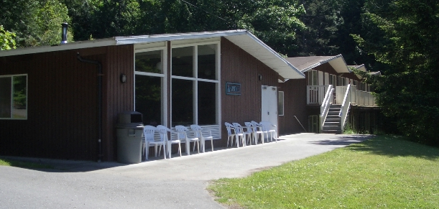
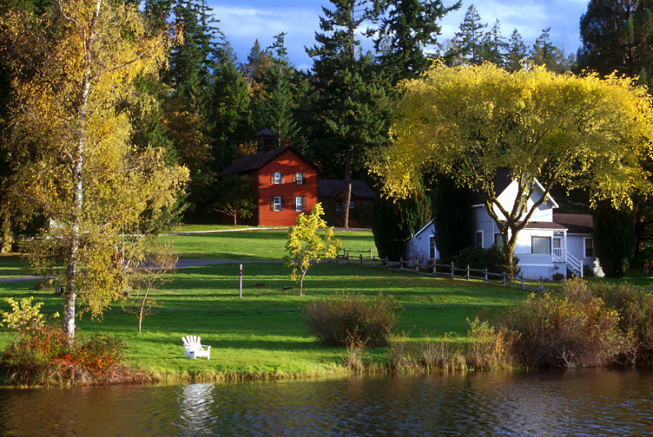
Seabeck, Washington

Slide 84
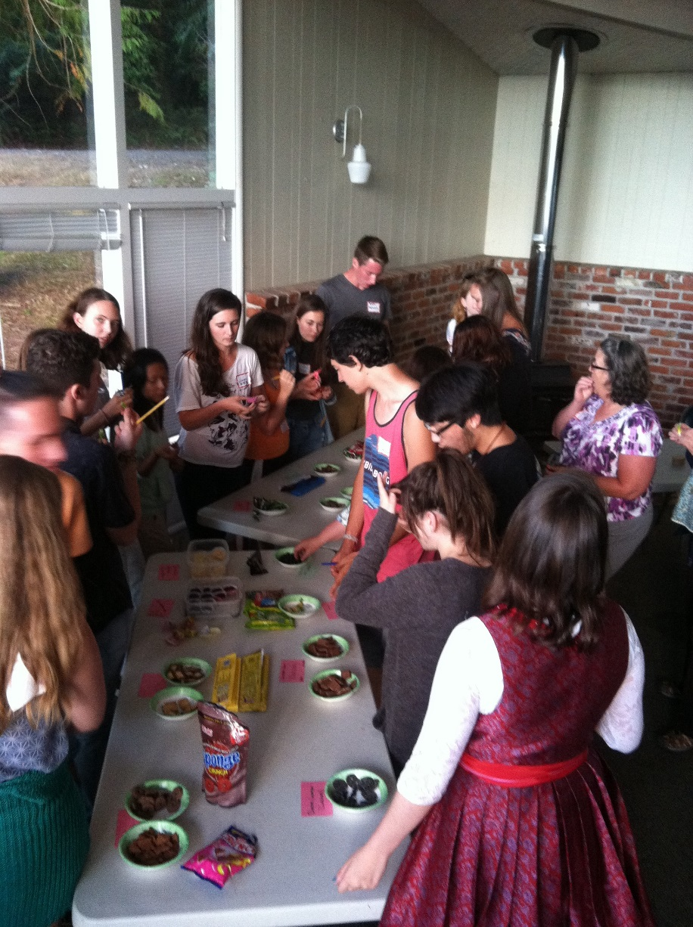
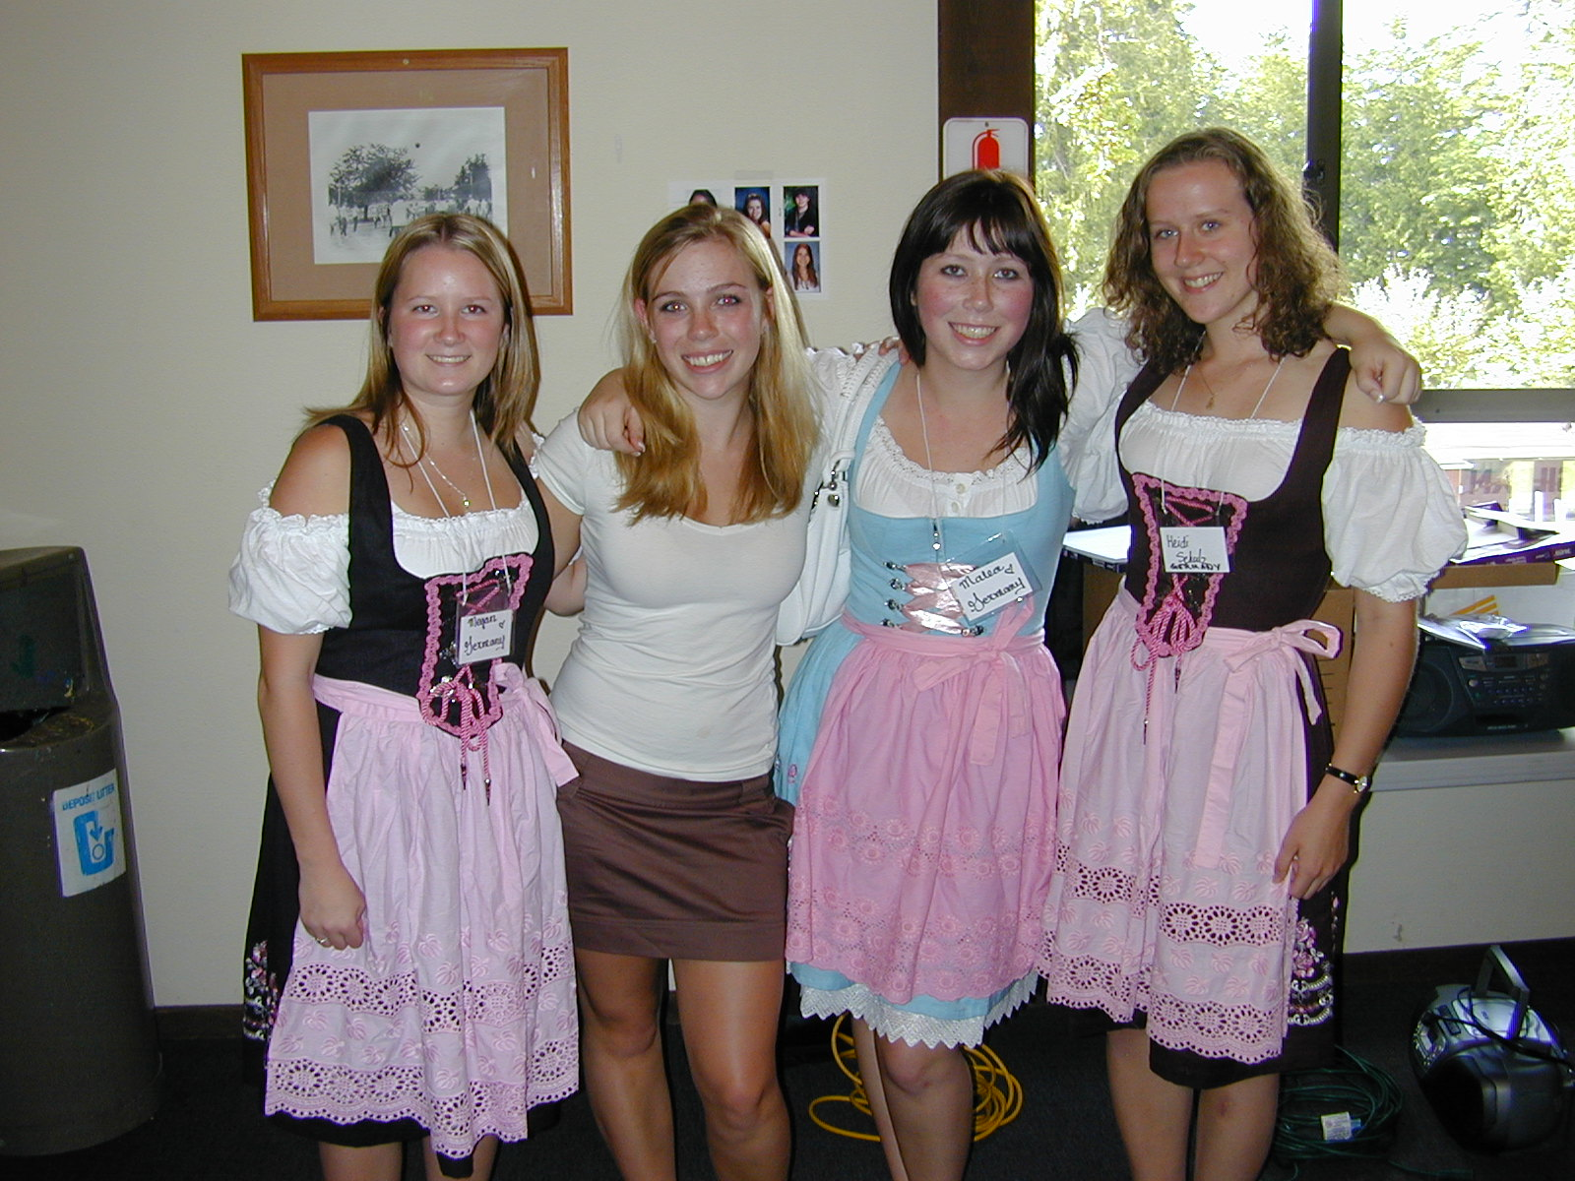
Rebound Weekend – for students who complete their exchange

Slide 85
Rebound Communication and Expectations
Reminder emails start in January
An outbound Facebook page will be started and you will be expected to join it – it is the primary source of communication with students
The food and lodging (non-refundable) were included in your outbound fees
You must attend if you want to be a part of the ROTEX activities

Slide 86
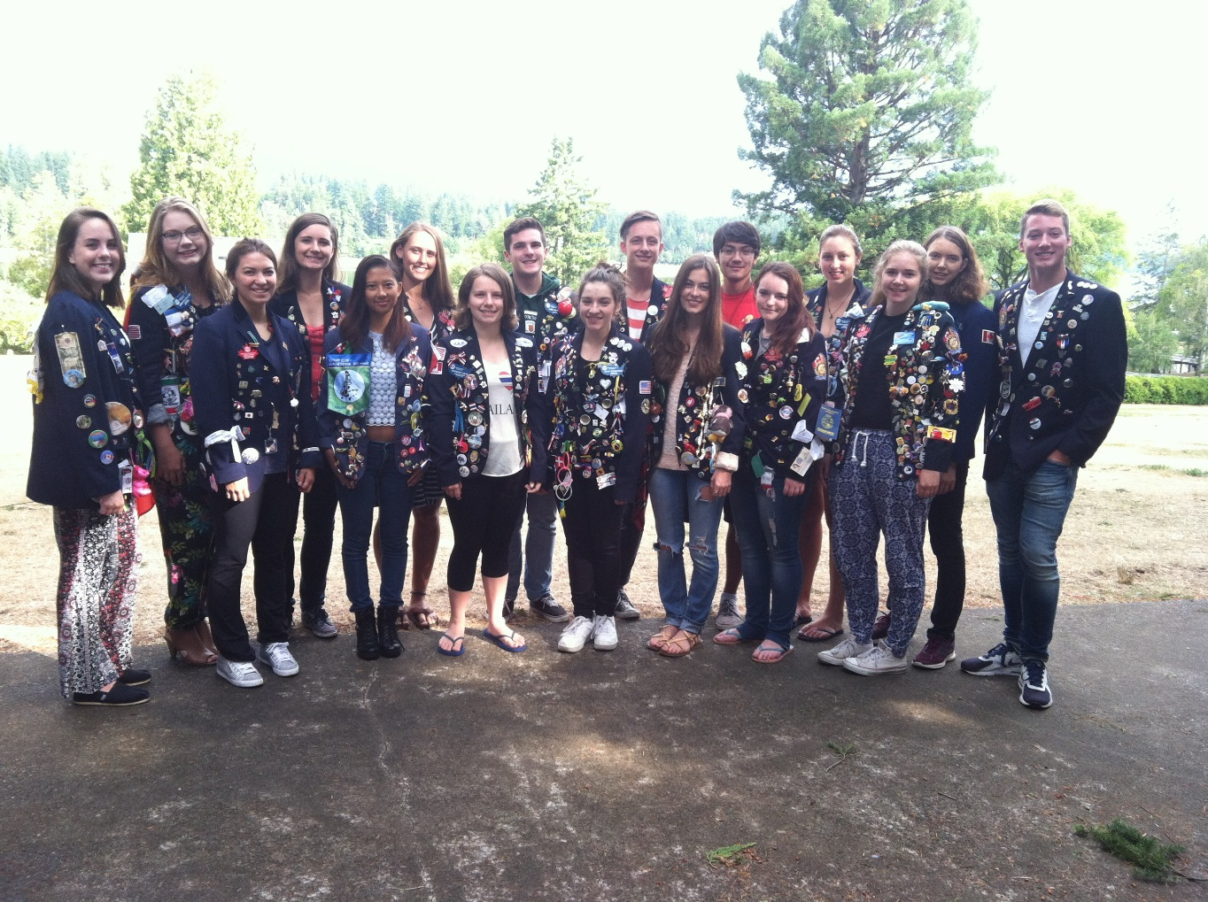
Reconnect, reflect and re-enter
Typically the second weekend in August

Slide 87
Rebound Parents Panel
Craig Gillis

Slide 88
Summation, Questions, and Feedback
RYE Committee

Slide 89

Presentation of Regalia

